Slide 1

Lighting Talks Peter Lorimer – Aspect Oriented Programming Simon Yewchuk – Introduction to Xamarin Doug Marquardt – Simple WPF Data Binding
April 24th, 2018

Slide 2
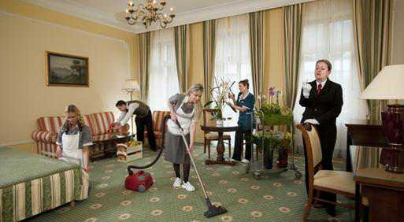
Housekeeping
Please join our Meetup page and click attending button.
Still working on May meetup.
Hiring or looking for work?
Anything else interesting?
SQL Saturday 710 – May 5th
Girls Learning Code Day – May 12th

Slide 3

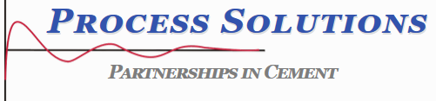


Thanks to Our Sponsors
Are you interested in being a sponsor? Let use know.
Notes:
Postsharp, ReSharper, RebDeBug, Microsoft, Process Solutions, Cloudtrend, Infragistics, Pluralsight, Azure, Windows Phone, Xamarin, Ncover, Microsoft Press, Apress, O’Reilly

Slide 4
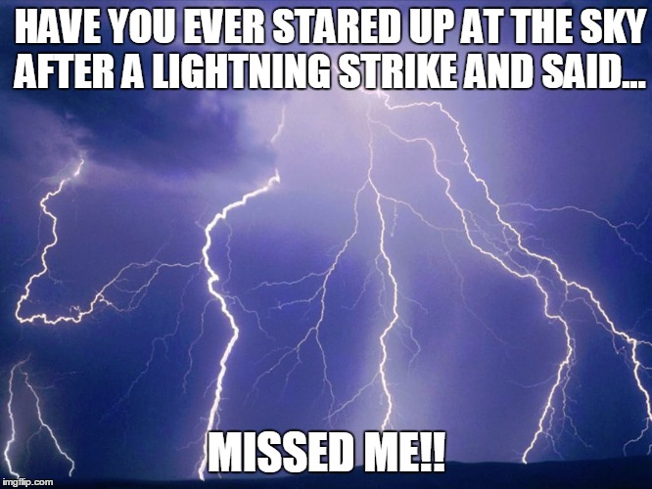
Lighting Talks
Peter Lorimer Aspect Oriented Programming
Simon Yewchuk Introduction to Xamarin
Doug Marquardt Simple WPF Data Binding

Slide 5
Wrap-up
Survey and prize draw! Constructive feedback appreciated.
Next meetup TBD.
Contact: info@edmug.net http://edmug.net
Notes:
Don’t forget to thank sponsors. Ask for presenters, etc.

